Slide 1
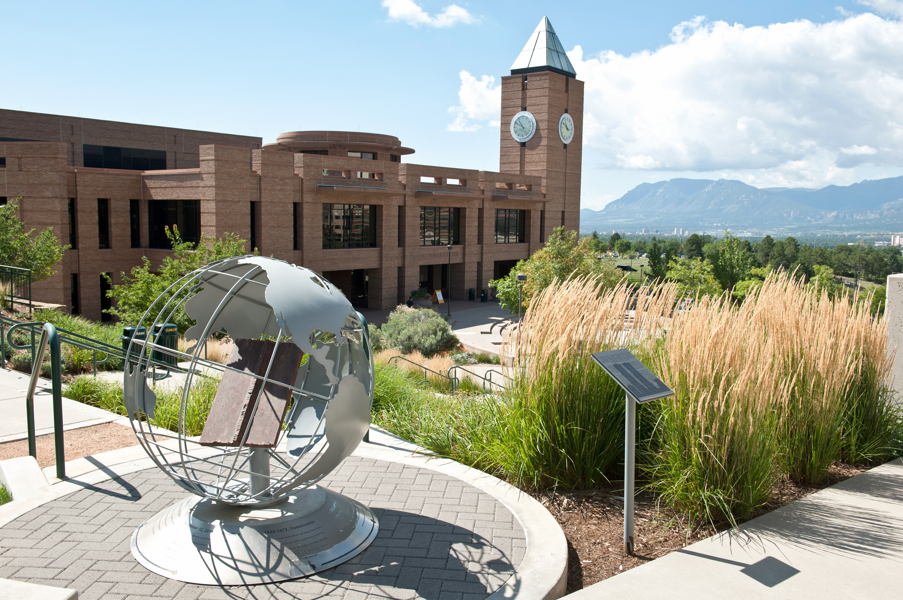
UCCS
2021 Campus Workplace & Culture Survey
Response Rates
CU Board of Regents
January 2022 Retreat

Slide 2
UCCS Response Rates per Survey
Survey | Population | Respondents | Response Rate
Undergraduate | 9595 | 1928 | 20%
Graduate | 1950 | 417 | 21%
Faculty | 854 | 414 | 48%
Staff | 799 | 582 | 73%
Respondents include partial completers.

Slide 3
UCCS Response Rates by Gender & Ethnicity
Group | Undergrads | Grads | Faculty | Staff
Response Rate | 20% | 21% | 48% | 73%
Gender: Female (F) Male (M) | 19% 12% | 19% 17% | 44% 35% | 69% 52%
Race/Ethnicity: BIPOC White | 19% 21% | 24% 21% | 41% 53% | 66% 75%
Notes:
BIPOC includes the following race/ethnic groups: American Indian or Alaska Native, Asian or Asian American, Black or African American, Latina/Latino/Latinx/Hispanic, Southwest Asian/Middle Eastern/North African, Native Hawaiian or Pacific Islander.
The numerator reflects the number of people who respondent to the corresponding question in the survey. The denominator is the number of people categorized in each gender or race/ethnicity in the Fall 2021 census. The overall response rate includes individuals who might have skipped a specific survey question.

Slide 4
UCCS Response Rates by Unit
Unit | Undergrads | Grads | Faculty | Staff
Business | 23% | 18% | 39%
Education | 30% | 23% | 49%
Engineering | 26% | 22% | 36%
Letters Arts Sciences | 19% | 31% | 52%
Beth-El | 23% | 14% | 50%
Public Affairs | 17% | 26% | 49%
Academic Affairs |  |  |  | 80%
Admin & Finance |  |  |  | 61%
Advancement |  |  |  | 92%
Student Affairs |  |  |  | 53%
Chancellor/HR/IT |  |  |  | 80%

Slide 5
UCCS Respondent Profile
Group | Undergrads | Grads | Faculty | Staff
Total Count | 1928 | 417 | 414 | 582
Gender: Female (F) Male (M) Neither (X) | 1000 (52%) 525 (27%) 33 (2%) | 222 (53%) 129 (31%) 6 (1%) | 207 (50%) 135 (33%) 2 (0.5%) | 323 (55%) 172 (30%) 5 (1%)
Race/Ethnicity: BIPOC White | 685 (36%) 1227 (64%) | 128 (31%) 273 (65%) | 68 (16%) 317 (77%) | 123 (21%) 438 (75%)
First-generation | 536 (28%) | 132 (32%) | n/a | n/a
Party: Democrat Independent Republican Other/NA | 338 (18%) 303 (16%) 255 (13%) 1032 (54%) | 115 (28%) 72 (17%) 40 (10%) 190 (46%) | 139 (34%) 74 (18%) 29 (7%) 172 (42%) | 174 (30%) 83 (14%) 78 (13%) 247 (42%)
Notes:
Showing a respondent profile rather than response rates per demographic group because UCCS opted to anonymize the survey such that responses are not tied to individuals and response rates are not calculable.
BIPOC includes the following race/ethnic groups: American Indian or Alaska Native, Asian or Asian American, Black or African American, Latina/Latino/Latinx/Hispanic, Southwest Asian/Middle Eastern/North African, Native Hawaiian or Pacific Islander.

Slide 6
Survey Administration
Four surveys:
  Undergraduate students
  Graduate students
  Staff employees
  Faculty employees
Surveys administered Oct 12 – Nov 30, 2021
All completers received a $5 gift card of their choice
Student respondents were eligible to win one of five parking permits for the Spring 2022 semester

