Slide 1
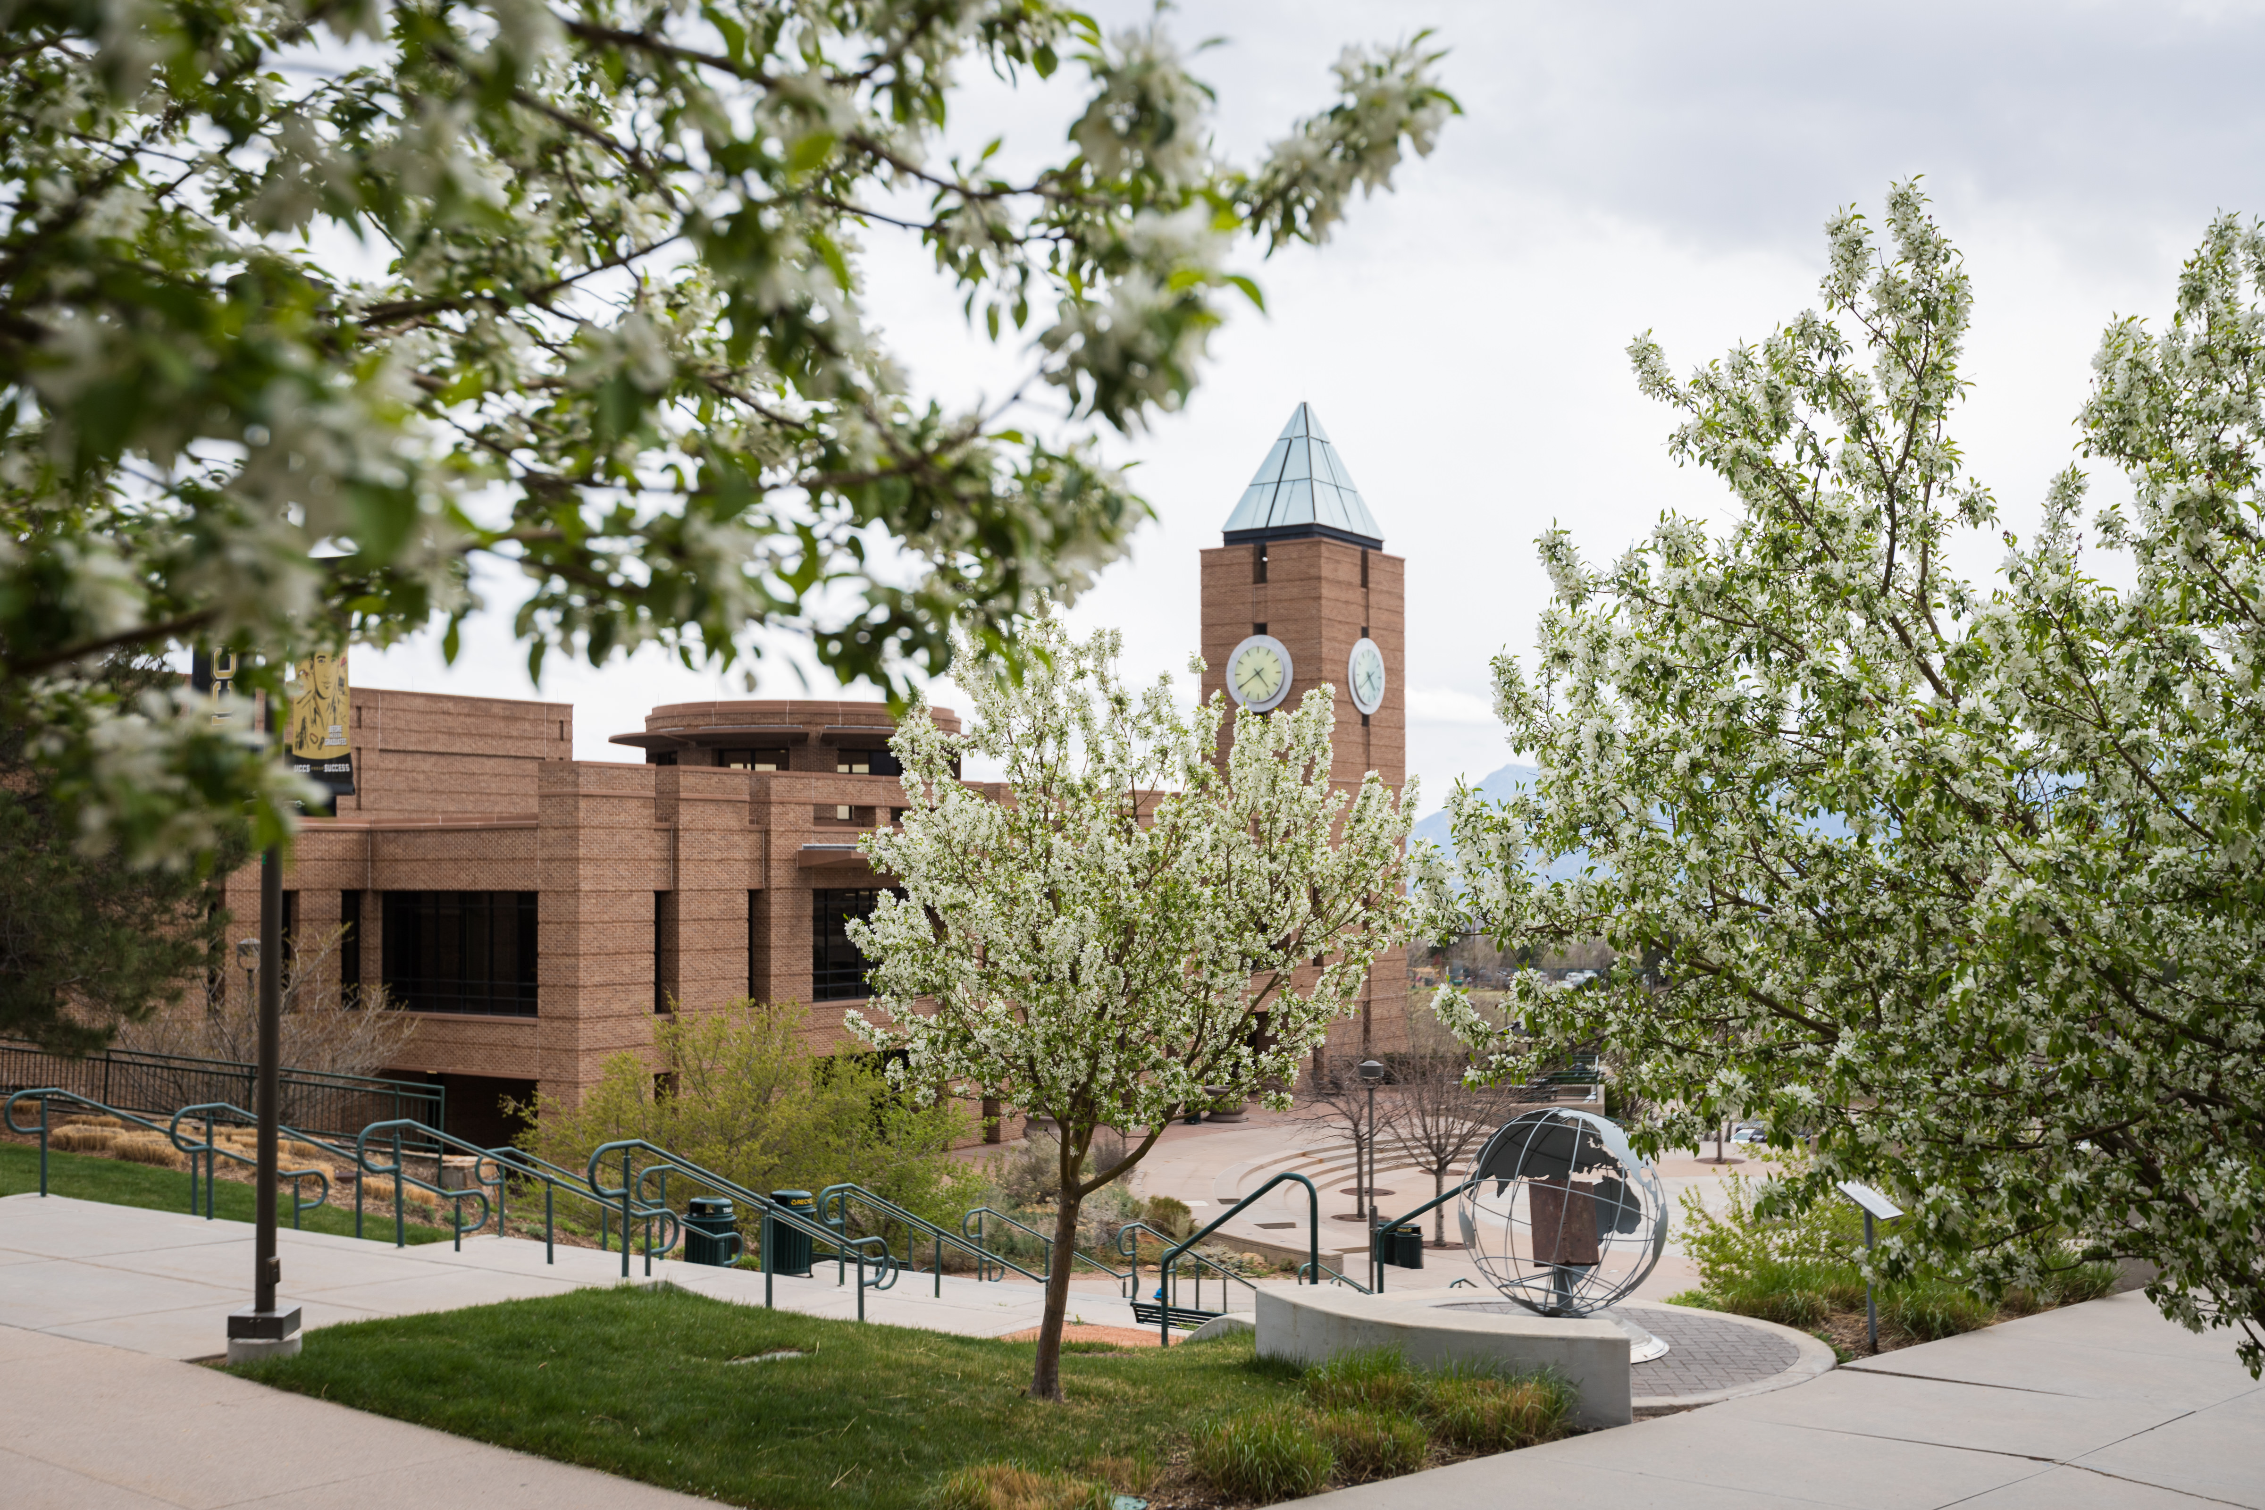
UCCS
2021 Campus Workplace & Culture Survey
Strategic Metric Summary
CU Board of Regents
February 2022 Meeting

Slide 2
Outline
The CU President’s Office identified five questions tied to the strategic plan within each of the four Campus Workplace & Culture Surveys (grad, undergrad, faculty, and staff). The results were presented to the Board of Regents in February 2022 in a separate PowerPoint available in BoardDocs. The following slides show more detailed response sets for each of the five questions per survey.
Comfortable Expressing Ideas
Harassment & Discrimination
Incivility
Work & Life Balance
Wellness

Slide 3
UCCS Response Rates per Survey
Survey | Population | Respondents | Response Rate
Undergraduate | 9595 | 1928 | 20%
Graduate | 1950 | 417 | 21%
Faculty | 854 | 414 | 48%
Staff | 799 | 582 | 73%
Respondents include partial completers.

Slide 4
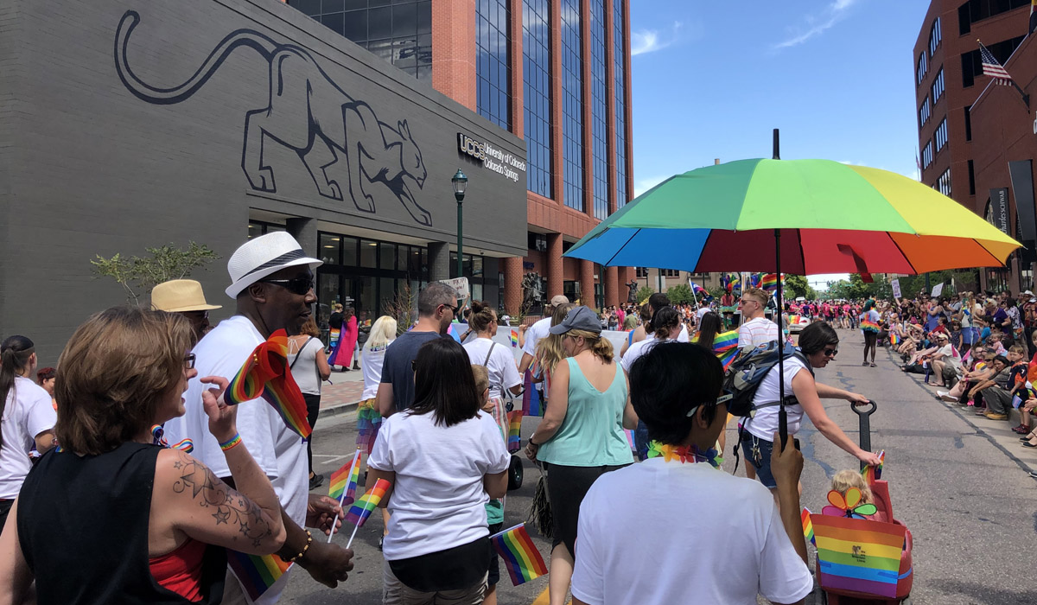
Comfortable Expressing Ideas

Slide 5
I. Comfortable Expressing Ideas - Summary
I am comfortable expressing ideas or opinions without fear it will affect how people in the class/department treat me.

Slide 6
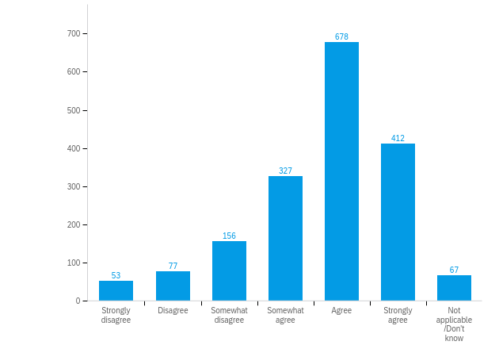
I. Comfortable Expressing Ideas - Undergrads
Undergraduate Students: I am comfortable expressing ideas or opinions in class without fear it will affect how people in the class treat me.
N = 1928
92% responded
8% did not respond

Slide 7
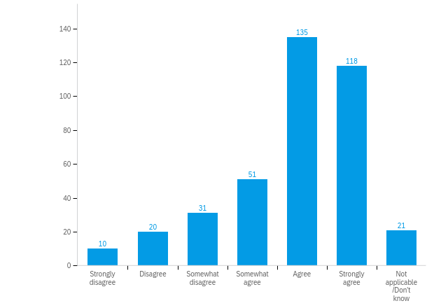
I. Comfortable Expressing Ideas – Grad Students
Graduate Students: I am comfortable expressing ideas or opinions without fear it will affect how individuals in my department treat me.
N = 417
93% responded
7% did not respond

Slide 8
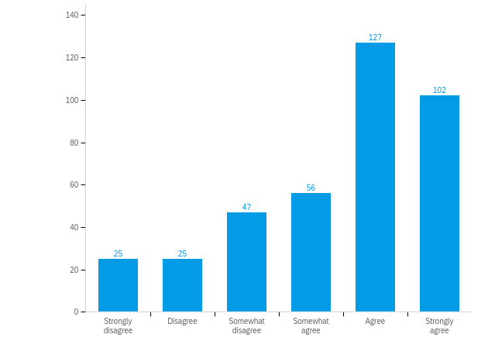
I. Comfortable Expressing Ideas - Faculty
Faculty: I am comfortable expressing ideas or opinions in class without fear it will affect how people in the class treat me.
N = 414
92% responded
8% did not respond

Slide 9
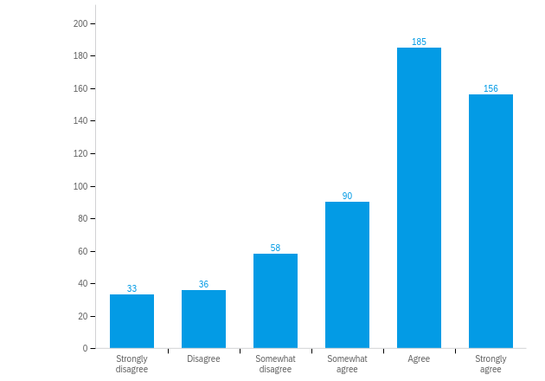
I. Comfortable Expressing Ideas - Staff
Staff: I am comfortable expressing ideas or opinions in class without fear it will affect how people in the class treat me.
N = 582
96% responded
4% did not respond

Slide 10
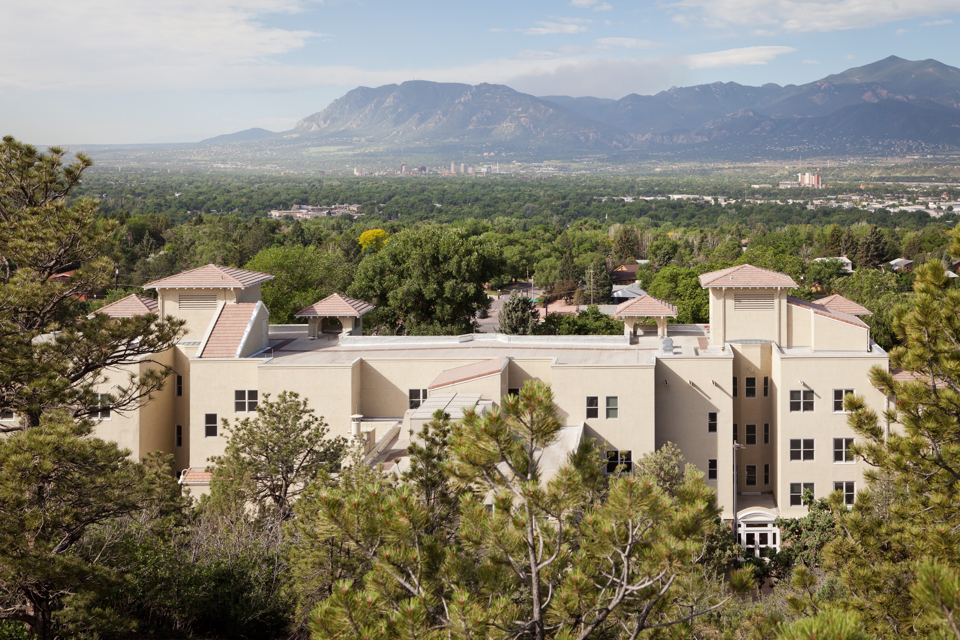
Harassment & Discrimination

Slide 11
I. Harassment & Discrimination - Summary
If I reported discrimination or harassment, my concerns would be taken seriously by my campus.

Slide 12
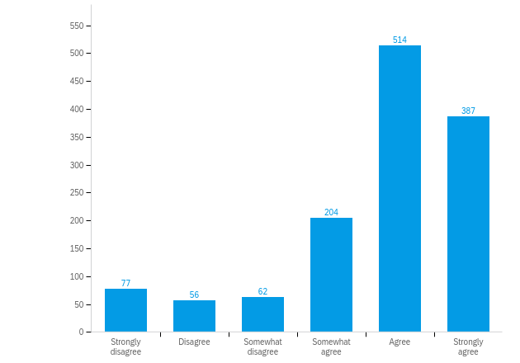
II. Harassment & Discrimination - Undergrads
Undergraduate Students: If I reported discrimination or harassment, my concerns would be taken seriously by my campus.
N = 1928
67% responded
33% did not respond

Slide 13
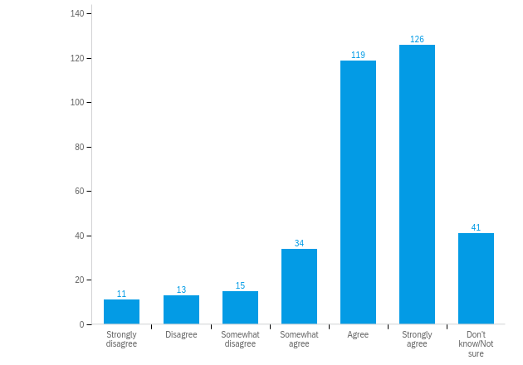
II. Harassment & Discrimination – Grad Students
Graduate Students: If I reported discrimination or harassment, my concerns would be taken seriously by my campus.
N = 417
86% responded
14% did not respond

Slide 14
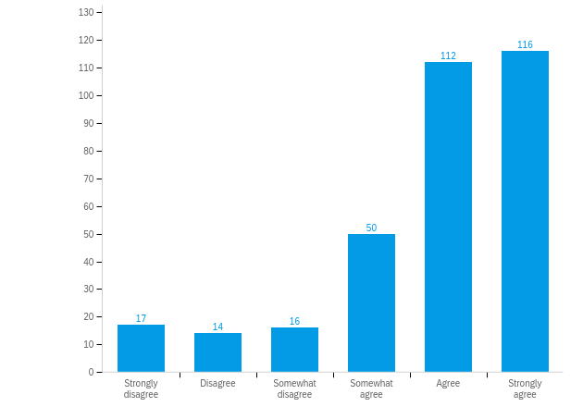
II. Harassment & Discrimination - Faculty
Faculty: If I reported discrimination or harassment, my concerns would be taken seriously by my campus.
N = 414
78% responded
22% did not respond

Slide 15
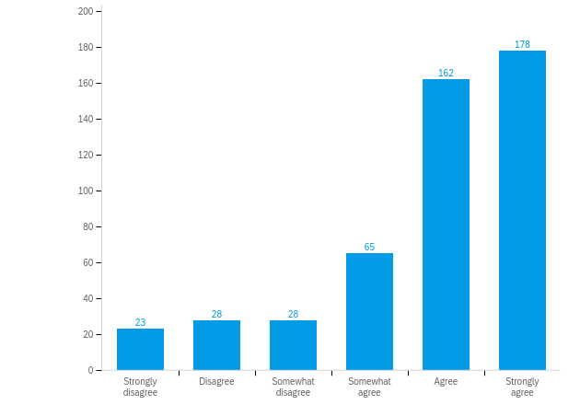
II. Harassment & Discrimination - Staff
Staff: If I reported discrimination or harassment, my concerns would be taken seriously by my campus.
N = 582
83% responded
17% did not respond

Slide 16

Incivility

Slide 17
III. Incivility - Undergrads
Undergraduate Students: ...have you experienced any of these behaviors in the context of your CU-related activities? (54% have not; 16% did not respond)

Slide 18
III. Incivility – Grad Students
Graduate Students: ...have you experienced any of these behaviors in the context of your CU-related activities? (53% have not; 12% did not respond)

Slide 19
III. Incivility - Faculty
Faculty: ...have you experienced any of these behaviors in the context of your CU-related activities? (46% have not; 11% did not respond)

Slide 20
III. Incivility - Staff
Staff: ...have you experienced any of these behaviors in the context of your CU-related activities? (42% have not; 2% did not respond)

Slide 21
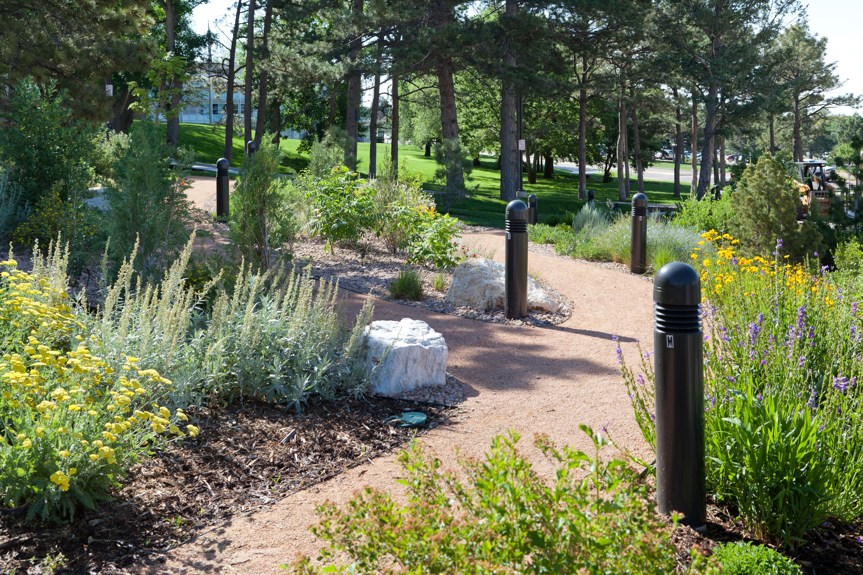
Work & Life Balance

Slide 22
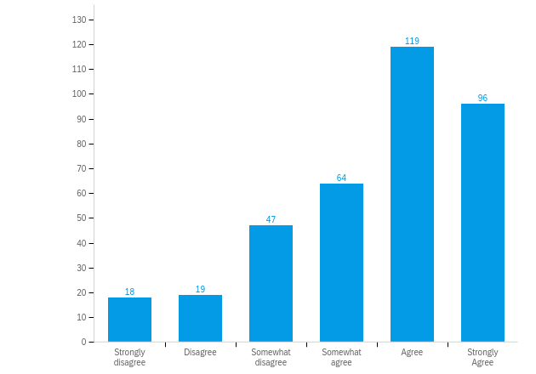
IV. Work & Life Balance - Faculty
Faculty: My department values the balance between my job and life outside the work setting.
N = 414
88% responded
12% did not respond

Slide 23
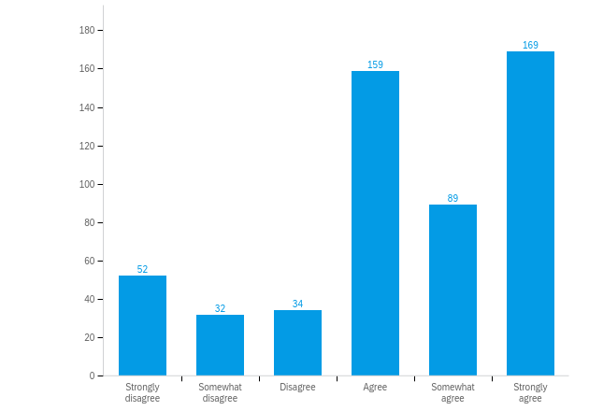
IV. Work & Life Balance - Staff
Staff: My department values the balance between my job and life outside the work setting.
N = 582
92% responded
8% did not respond

Slide 24
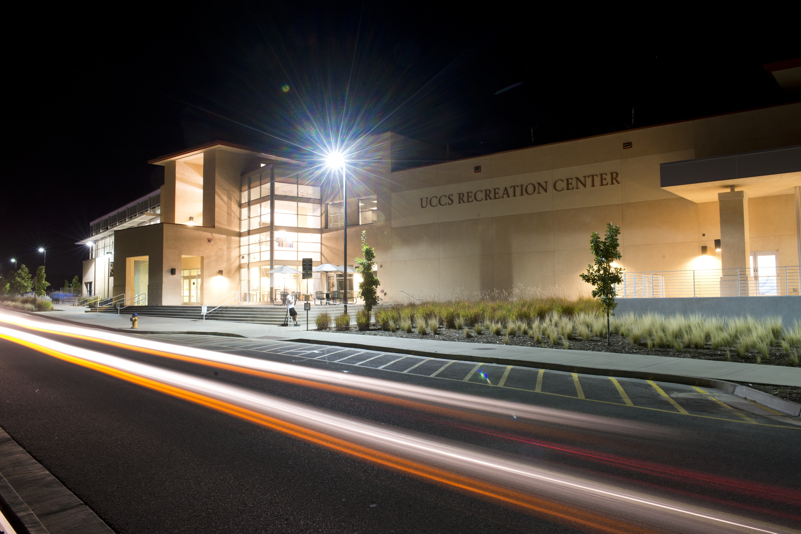
Wellness Programs

Slide 25
V. Wellness Programs - Faculty
Faculty: ...barriers that prevent you from participating in wellness-at-work programs (top ten shown; 7% did not respond)

Slide 26
V. Wellness Programs - Staff
Staff: ...barrier that prevents you from participating in wellness-at-work programs (top ten shown; 6% did not respond)

